Slide 1
Chapter 14
Linear Regression

Slide 2
Outline
Points and Lines
Linear Regression
R-squared and the Variance of Residuals
Summary
Self-Quiz Unit 6
Graded Quiz Unit 6
Assignment Unit 6

Slide 3
Points and Lines
A scatter plot is a graph that displays jointly the data of two numerical variables.
A scatter plot is a useful tool to examine the relation between two variables.
You can read more about scatter plots in the book and let me know if you have any questions.
Another tool used to examine the relation between variables is the linear regression.
Linear regression describes linear trends in the relation between a response and an explanatory variable.
A regression line is the line that best describes the linear trend of the relation between the explanatory variable and the response.

Slide 4
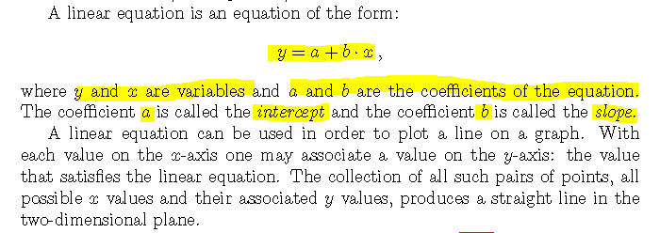
Points and Lines

Slide 5
Linear Regression
Data that describes the joint distribution of two numeric variables can be represented with a scatter plot.
The y-axis in this plot corresponds to the response and the x-axis corresponds to the explanatory variable.
The regression line describes the linear trend of the response as a function of the explanatory variable.
This line is characterized by a linear equation with an intercept and a slope that are computed from the data.
The R function that ts the regression line to data is called “lm", an acronym for Linear Model.
The input to the function is a formula, with the response variable to the left of the tilde character and the explanatory variable to the right of it.
The output of the function is the fitted linear regression model.

Slide 6
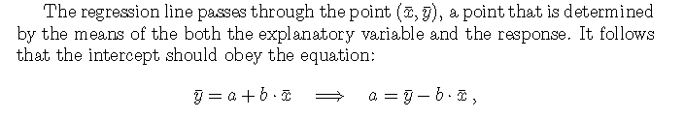
Linear Regression
The coefficients of the regression line are computed from the data and are hence statistics.
Specifically, the slope of the regression line is computed as the ratio between the covariance of the response and the explanatory variable, divided by the variance of the explanatory variable.
The intercept of the regression line is computed using the sample averages of both variables and the computed slope.

Slide 7
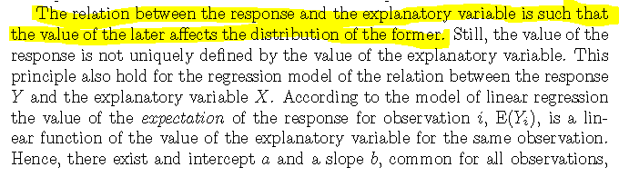
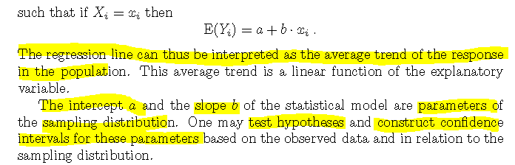
Linear Regression

Slide 8
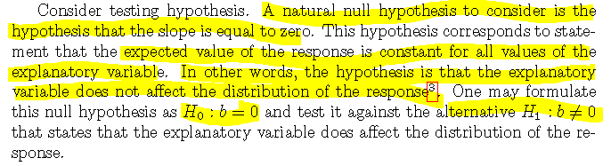
Linear Regression

Slide 9
R-squared and the Variance of Residuals
https://www.khanacademy.org/math/statistics-probability/describing-relationships-quantitative-data/regression-library/v/introduction-to-residuals-and-least-squares-regression
https://www.khanacademy.org/math/statistics-probability/describing-relationships-quantitative-data/more-on-regression/v/calculating-r-squared
https://www.khanacademy.org/math/ap-statistics/bivariate-data-ap/assessing-fit-least-squares-regression/v/standard-dev-residuals

Slide 10
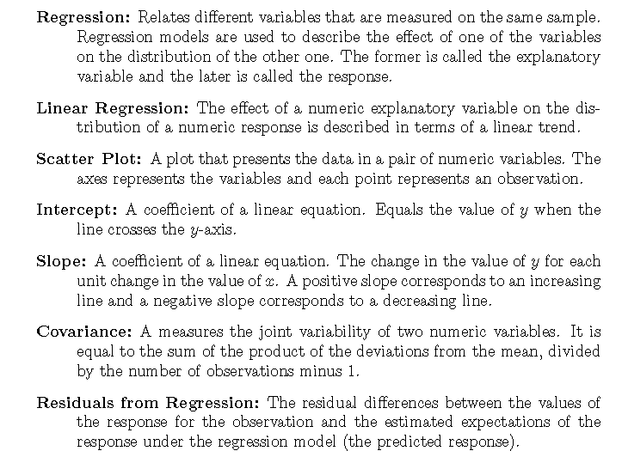
Summary

Slide 11
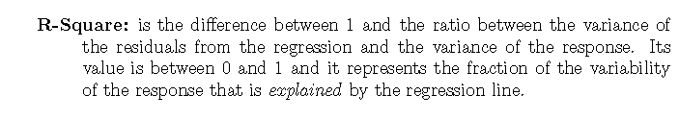
Summary

Slide 12
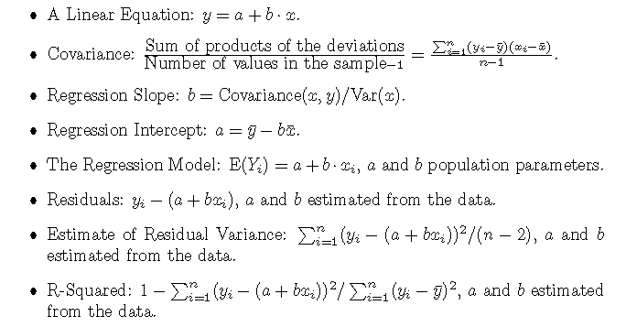
Summary

Slide 13
Self-Quiz Unit 6
# Q1- Q4: https://youtu.be/C4fBOSuujmg
# Q5 - Q10:https://youtu.be/AN2actbWWFg

Slide 14
Graded Quiz Unit 6
https://docs.google.com/document/d/1-8haJfdL2ycqor-hPNvefacPHzfQRuksSH8QakVx0nI/edit?usp=sharing

Slide 15
Assignment Unit 6
# https://youtu.be/Zk2fVkEJYNg
# You can use the function abline() to add a regression line to a function

